Slide 1
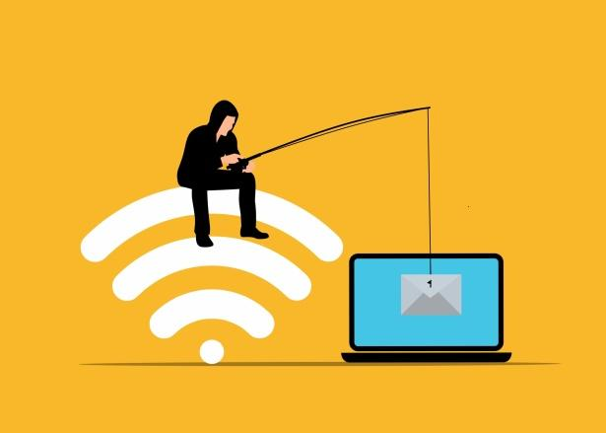
Phishing Awareness Training Module
Cyber Security Internship Project
Vivek prajapati
Cyber Security Intern at CodeAlpha

Slide 2

Phishing is one of the most common cyber attacks today.
It is used by attackers to steal:
Passwords
Bank details
OTP
Personal information

Slide 3

What is Phishing?
Phishing is a cyber attack where criminals pretend to be a trusted organization to trick users.
They send:
Fake emails
Fake messages
Fake websites
Goal: Steal sensitive information.

Slide 4


Why Phishing is Dangerous?
Many cyber attacks start with phishing.
Phishing can cause:
Financial loss
Identity theft
Account compromise
Data breach
Company reputation damage

Slide 5
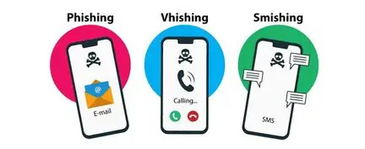
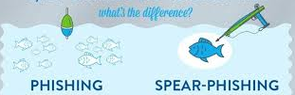
Types of Phishing
Email Phishing
Spear Phishing (Targeted attack)
Smishing (SMS phishing)
Vishing (Voice call phishing)
Clone Phishing

Slide 6
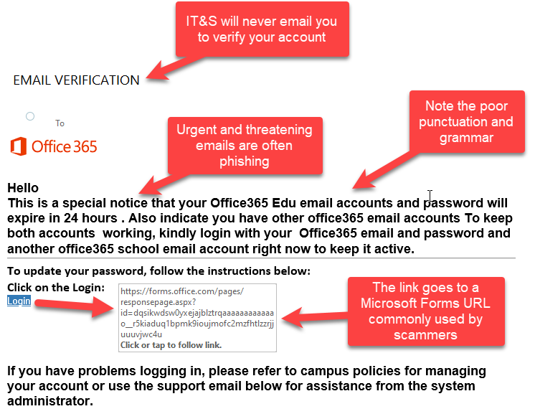
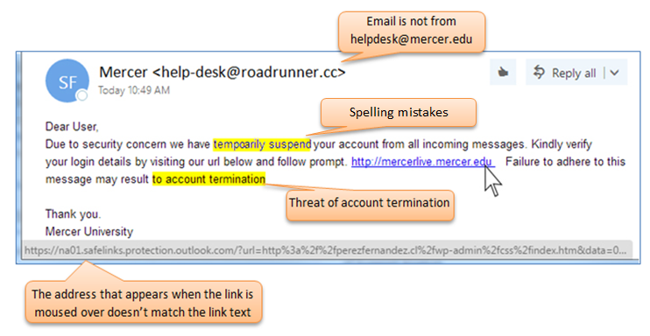
Email Phishing Example
Example message:
Warning signs:
Urgent language
Suspicious link
Unknown sender
Spelling mistakes
“Your bank account will be suspended. Click here immediately to verify.”

Slide 7
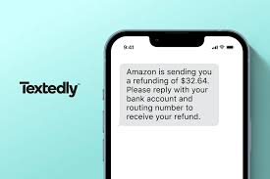
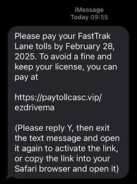
Social Engineering
Phishing attacks use psychological tricks:
Fear (“Your account will be blocked”)
Urgency (“Act now!”)
Authority (“From bank manager”)
Greed (“You won a prize”)

Slide 8
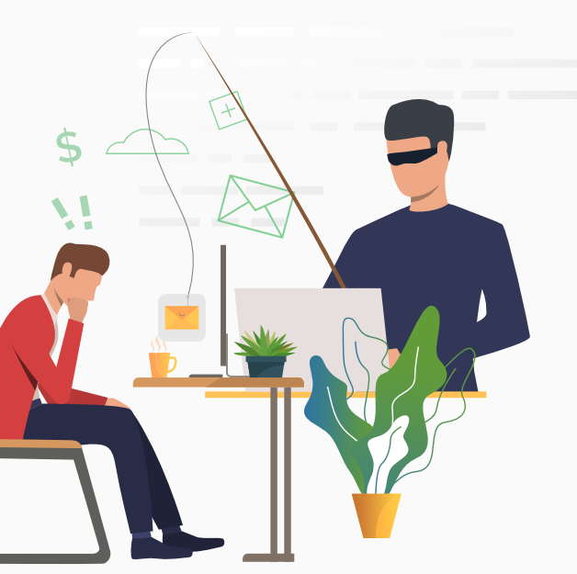
How to Identify Phishing
Always check:
✔ Sender’s email address
✔ URL before clicking
✔ Spelling mistakes
✔ Unexpected attachments
✔ Threatening language
If unsure, verify from official website

Slide 9

Prevention Methods
Enable 2-Factor Authentication (2FA)
Use strong passwords
Do not click unknown links
Keep software updated
Report suspicious emails
Awareness is the best defense

Slide 10
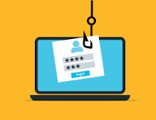
Conclusion
Phishing is a serious cybersecurity threat.
By understanding attack methods and following prevention practices, individuals and organizations can reduce risk.
Cyber awareness saves data and money
Quiz link :https://docs.google.com/forms/d/e/1FAIpQLScIsdAMaoMaGAkGWOBRfx_IKpLp-L09L7rekmU7n-rPY6sJTg/viewform?usp=header

